Slide 1

Notes:
Thank the Sponsors, Organizers, Volunteers, and the Attendees

Slide 2



09.24.24
Hands-on with React 19
A roadmap to upgrading your applications
Jerecho Giba
Lead Developer
Consultant
Mechanical Keyboard Enthusiast

Slide 3
AGENDA
AGENDA
01
Why React?
02
How would it affect you?
03
What’s new in React 19?
04
Upgrading to React 19
05
Q & A
3

Slide 4


Why React?
4

Slide 5








React 19 – Usage Statistics
React Usage Statistics
700,971
186,420 (18%)
25,218,845
Websites in Canada
Top 1 million sites by traffic
npm weekly downloads
Reference: https://trends.builtwith.com/javascript/React/Canada https://trends.builtwith.com/websitelist/React/Top-Million-Sites-by-Traffic
https://www.npmjs.com/package/react
5

Slide 6



React - TIMELINE
May 29, 2013
Initial Release Date
February 2019
Hooks was introduced on React 16.8
October 20, 2020
React 17 was released
6

Slide 7



React - TIMELINE
March 2022
React 18 was released
MAY 2023
Canary Release Channel rollout
April 25, 2024
React 19 Beta! React 19 was upgraded from Canary to RC (Release Candidate)
7

Slide 8
How would it affect me?
8
Notes:
Things that you don’t need to manually do (React Compiler)
Future deprecations
ForwardRef, Context.Provider

Slide 9
React 19 – Compiler
React Compiler
9
Notes:
React Compiler is a build-time only tool that optimizes your React applications by automatically memorizing your code
It works with plain JavaScript, and understands the Rules of React, so you don’t need to rewrite any code to use it

Slide 10


React 19
React Compiler
.JSX
10
Notes:
React Compiler is a build-time only tool that optimizes your React applications by automatically memorizing your code

Slide 11


React 19
React Compiler
.JSX
Optimized!✨
11
Notes:
React Compiler is a build-time only tool that optimizes your React applications by automatically memorizing your code

Slide 12
React 19
React Compiler
React Hooks and API for Optimization
useCallback()
cache a function definition
useMemo()
cache the result of a calculation
memo()
skips unnecessary rendering
12
Notes:
With these APIs you can tell React that certain parts of your application don’t need to recompute if their inputs haven’t changed, reducing work on updates. While powerful, it’s easy to forget to apply memoization or apply them incorrectly.

Slide 13
React 19
React Compiler
React Hooks and API for Optimization
useCallback()
cache a function definition
NO MORE MEMOIZATION!
useMemo()
cache the result of a calculation
memo()
skips unnecessary rendering
13

Slide 14

React 19
React Compiler
React Hooks and API for Optimization
Manual
useCallback()
cache a function definition
NO MORE MEMOIZATION!
useMemo()
cache the result of a calculation
memo()
skips unnecessary rendering
14

Slide 15
React Compiler
React 19 – React Compiler
With Memoization
15

Slide 16
React Compiler
React 19 – React Compiler
With Memoization
function ProductPage({ productId, referrer, theme }) {
const handleSubmit = useCallback((orderDetails) => {
post('/product/' + productId + '/buy', {
referrer,
orderDetails,
});
}, [productId, referrer]);
return (
<div className={theme}>
<ShippingForm onSubmit={handleSubmit} />
</div>
);
}
Reference: https://react.dev/reference/react/useCallback
16

Slide 17

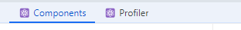
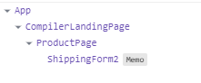
React Compiler
React 19 – React Compiler
With Memoization
function ProductPage({ productId, referrer, theme }) {
const handleSubmit = useCallback((orderDetails) => {
post('/product/' + productId + '/buy', {
referrer,
orderDetails,
});
}, [productId, referrer]);
return (
<div className={theme}>
<ShippingForm onSubmit={handleSubmit} />
</div>
);
}
memo component
const ShippingForm =
memo(function ShippingForm({ onSubmit})
Reference: https://react.dev/reference/react/useCallback
17

Slide 18
React 19 Compiler
React 19 – React Compiler
Without Memoization
function ProductPage({ productId, referrer, theme }) {
const handleSubmit = (orderDetails) => {
post('/product/' + productId + '/buy', {
referrer,
orderDetails,
});
};
return (
<div className={theme}>
<ShippingForm onSubmit={handleSubmit} />
</div>
);
}
memo component
function ShippingForm({ onSubmit})
18

Slide 19
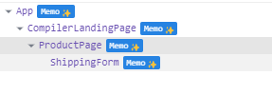
React 19 Compiler
React 19 – React Compiler
Without Memoization
function ProductPage({ productId, referrer, theme }) {
const handleSubmit = (orderDetails) => {
post('/product/' + productId + '/buy', {
referrer,
orderDetails,
});
};
return (
<div className={theme}>
<ShippingForm onSubmit={handleSubmit} />
</div>
);
}
memoized ✨
memoized ✨
function ShippingForm({ onSubmit})
19
Notes:
React Compiler only memoizes React components and hooks, not every function

Slide 20
React Compiler
React 19 – React Compiler
Playground
https://playground.react.dev/
20

Slide 21
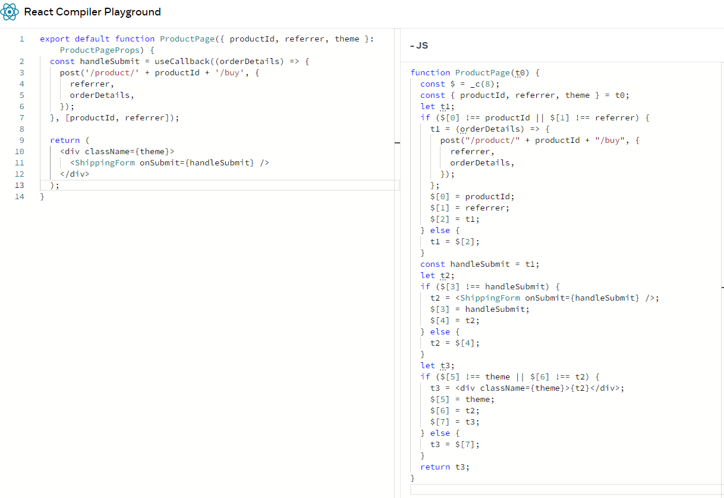
React Compiler
React 19 – React Compiler
Playground
https://playground.react.dev/
21

Slide 22




React Compiler
React 19 – React Compiler
Playground
https://playground.react.dev/
with memoization
22

Slide 23
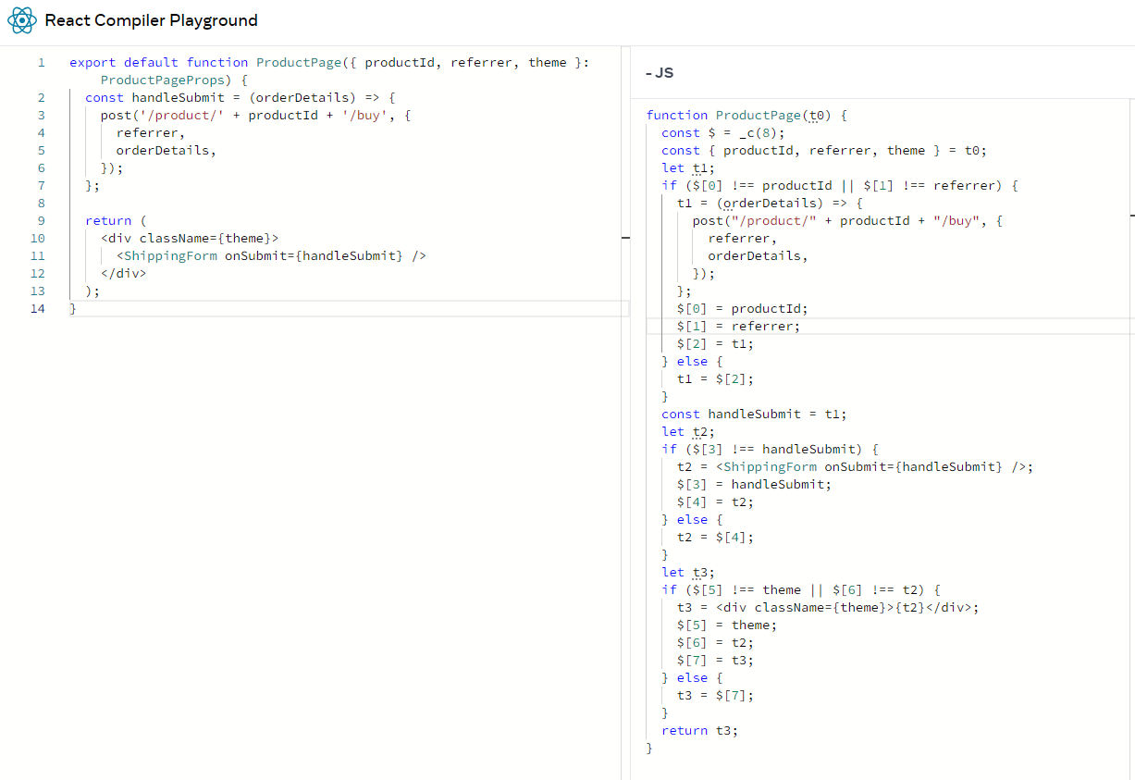
React 19 Compiler
React 19 – React Compiler
Playground
https://playground.react.dev/
23

Slide 24


React 19 Compiler
React 19 – React Compiler
Playground
https://playground.react.dev/
without memoization
24
Notes:
Note: React compiler only optimizes components and hooks and not all functions. If a component gives you a warning that it doesn’t abide by the rules of react, it will skip it and just convert it normally.
OrderDetails is not part of the dependency check on the compiled javascript file (Right side of the code) because it will not cause a re-render of the component. Product Id and Referrer are Child properties that are used in the handleSubmit function, that if changed will cause a re-render on the ProductPage component. In-depth video: https://www.youtube.com/watch?v=PYHBHK37xlE

Slide 25


React Compiler
React 19 – React Compiler
How to use?
25
Notes:
the compiler is still experimental while it has been used in production at companies like Meta, rolling out the compiler to production for your app will depend on the health of your codebase and how well you’ve followed the Rules of React.
No need to rush

Slide 26
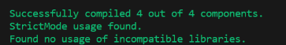
React Compiler
React 19 – React Compiler
How to use?
1 – Check for Compatibility (Rules of React)
npx react-compiler-healthcheck@experimental
2 – Install the eslint plugin
npx install eslint-plugin-react-compiler@experimental
3 – Install the react compiler plugin
npx install babel-plugin-react-compiler@experimental
26
Notes:
Prior to installing the compiler, you can first check to see if your codebase is compatible: 1 - Check how many components can be successfully optimized: higher is better, Check for incompatible library usage: known libraries that are incompatible with the compiler
2 - The eslint plugin can be used independently of the compiler, meaning you can use the eslint plugin even if you don’t use the compiler.

Slide 27
React Compiler
React 19 – React Compiler
How to use?
New Project
Existing Project
const ReactCompilerConfig = { };
// https://vitejs.dev/config/
export default defineConfig({
plugins: [react({
babel: {
plugins: [
["babel-plugin-react-compiler", ReactCompilerConfig],
],
},
})],
})
const ReactCompilerConfig = {sources: (filename) => {
return filename.indexOf('src/path/to/dir') !== -1;
}, };
// https://vitejs.dev/config/
export default defineConfig({
plugins: [react({
babel: {
plugins: [
["babel-plugin-react-compiler", ReactCompilerConfig],
],
},
})],
})
27
Notes:
Set specific folders or filenames to be React Compiler ready.

Slide 28
React 19 – Ref as a prop
Ref as a prop
28

Slide 29
Ref as a prop
React 19 – Ref as a Prop
With forwardRef
const MyInput = forwardRef(function MyInput(props, ref) {
return <input placeholder={props.placeholder} ref={ref} />
})
function MyForm() {
const ref = useRef(null);
const handleClick = () => ref.current.focus();
return (
<form>
<MyInput placeholder="Enter your name" ref={ref} />
<button type="button" onClick={handleClick}>
Edit
</button>
</form>
);
}
29
Notes:
ForwardRef lets your component expose a DOM node to parent component with ‘ref’

Slide 30
React 19 – Ref as a Prop
With forwardRef
const MyInput = forwardRef(function MyInput(props, ref) {
return <input placeholder={props.placeholder} ref={ref} />
})
function MyForm() {
const ref = useRef(null);
const handleClick = () => ref.current.focus();
return (
<form>
<MyInput placeholder="Enter your name" ref={ref} />
<button type="button" onClick={handleClick}>
Edit
</button>
</form>
);
}
Use forwardRef to let your component receive a ref
30
Notes:
ForwardRef lets your component expose a DOM node to parent component with ‘ref’

Slide 31
React 19 – Ref as a Prop
With forwardRef
const MyInput = forwardRef(function MyInput(props, ref) {
return <input placeholder={props.placeholder} ref={ref} />
})
function MyForm() {
const ref = useRef(null);
const handleClick = () => ref.current.focus();
return (
<form>
<MyInput placeholder="Enter your name" ref={ref} />
<button type="button" onClick={handleClick}>
Edit
</button>
</form>
);
}
Use forwardRef to let your component receive a ref
Create a ref with useRef
31
Notes:
useRef(initialValue)

Slide 32
React 19 – Ref as a Prop
With forwardRef
const MyInput = forwardRef(function MyInput(props, ref) {
return <input placeholder={props.placeholder} ref={ref} />
})
function MyForm() {
const ref = useRef(null);
const handleClick = () => ref.current.focus();
return (
<form>
<MyInput placeholder="Enter your name" ref={ref} />
<button type="button" onClick={handleClick}>
Edit
</button>
</form>
);
}
Use forwardRef to let your component receive a ref
Create a ref with useRef
Pass ref as a prop
32

Slide 33
React 19 – Ref as a Prop
With forwardRef
const MyInput = forwardRef(function MyInput(props, ref) {
return <input placeholder={props.placeholder} ref={ref} />
})
function MyForm() {
const ref = useRef(null);
const handleClick = () => ref.current.focus();
return (
<form>
<MyInput placeholder="Enter your name" ref={ref} />
<button type="button" onClick={handleClick}>
Edit
</button>
</form>
);
}
33

Slide 34
React 19 – Ref as a Prop
React 19✨ Without forwardRef
function MyInput({ ref, ...props }) {
return <input placeholder={props.placeholder} ref={ref} />
}
function MyForm() {
const ref = useRef(null);
const handleClick = () => ref.current.focus();
return (
<form>
<MyInput placeholder="Enter your name" ref={ref} />
<button type="button" onClick={handleClick}>
Edit
</button>
</form>
);
}
34
Notes:
ForwardRef lets your component expose a DOM node to parent component with ‘ref’

Slide 35
React 19 – Ref as a Prop
React 19✨ Without forwardRef
function MyInput({ ref, ...props }) {
return <input placeholder={props.placeholder} ref={ref} />
}
function MyForm() {
const ref = useRef(null);
const handleClick = () => ref.current.focus();
return (
<form>
<MyInput placeholder="Enter your name" ref={ref} />
<button type="button" onClick={handleClick}>
Edit
</button>
</form>
);
}
Access ref as a prop
35
Notes:
ForwardRef lets your component expose a DOM node to parent component with ‘ref’

Slide 36
React 19 – Ref as a Prop
React 19✨ Without forwardRef
function MyInput(props) {
return <input placeholder={props.placeholder} ref={props.ref} />
}
function MyForm() {
const ref = useRef(null);
const handleClick = () => ref.current.focus();
return (
<form>
<MyInput placeholder="Enter your name" ref={ref} />
<button type="button" onClick={handleClick}>
Edit
</button>
</form>
);
}
36
Notes:
ForwardRef lets your component expose a DOM node to parent component with ‘ref’

Slide 37
React 19 – Context
Context as a provider
37

Slide 38
React 19 – Context as a provider
Context as a provider
<Context.Provider>
const ThemeContext = createContext('');
function App({children}) {
return (
<ThemeContext.Provider value="dark">
{children}
</ThemeContext.Provider>
);
}
38

Slide 39
React 19 – Context as a provider
Context as a provider
<Context>
const ThemeContext = createContext('');
function App({children}) {
return (
<ThemeContext value="dark">
{children}
</ThemeContext>
);
}
39

Slide 40
React 19 – Use
New API: use
40

Slide 41
React 19 – Use
New API: use
use(promise)
use(context)
41
Notes:
When called with a Promise, the use API integrates with Suspense and error boundaries. The component calling use suspends while the Promise passed to use is pending use(Context) can be called inside conditionals like if statements and loops use needs to be called inside a Component or hook. (not a function)

Slide 42
React 19 – Use
New API: use
use(promise)
function Comments({commentsPromise}) {
// `use` will suspend until the promise resolves.
const comments = use(commentsPromise);
return comments.map(comment =>
<p key={comment.id}>{comment}</p>);
}
function Page({commentsPromise}) {
// When `use` suspends in Comments,
// this Suspense boundary will be shown.
return (
<Suspense fallback={<div>Loading...</div>}>
<Comments commentsPromise={commentsPromise} />
</Suspense>
)
}
42

Slide 43
React 19 – Use
New API: use
use(context)
function Comments({commentsPromise}) {
// `use` will suspend until the promise resolves.
const comments = use(commentsPromise);
const theme = use(ThemeContext);
return comments.map(comment =>
<p key={comment.id} style={{color: theme.color}}>{comment}</p>);
}
function Page({commentsPromise}) {
// When `use` suspends in Comments,
// this Suspense boundary will be shown.
return (
<Suspense fallback={<div>Loading...</div>}>
<Comments commentsPromise={commentsPromise} />
</Suspense>
)
}
43

Slide 44
What’s New?
44

Slide 45
React 19 – Actions
Actions
45
Notes:
Form action is a basic html functionality that’s already existing. Remix started a resurgence of action-based APIs in JS frameworks (such as React Router) which the React team took inspiration from

Slide 46
Actions
React 19 – Actions
React Action is a pattern for asynchronous data updates in response to user input
46
Notes:
A common use case in React apps is to perform a data mutation and then update state in response. For example, when a user submits a form to change their name, you will make an API request, and then handle the response. In the past, you would need to handle pending states, errors, optimistic updates, and sequential requests manually.

Slide 47

Actions
React 19 – Actions
Pre-React 19
const [name, setName] = useState("");
const [isPending, setIsPending] = useState(false);
const [error, setError] = useState("");
Change Name
const handleUpdate = async () => {
setIsPending(true);
const response = await updateName(name);
setIsPending(false);
//… setError(response.error);
};
Name
Jerecho Giba
UPDATE
return (
<div>
<input onChange={(e) => setName(e.target.value)}/>
<button onClick={handleUpdate}>
{isPending ? “UPDATING..” : “UPDATE”}
</button>
{error && <span> error </span>}
</div>
)
47

Slide 48

Actions
React 19 – Actions
Pre-React 19
const [name, setName] = useState("");
const [isPending, setIsPending] = useState(false);
const [error, setError] = useState("");
Change Name
const handleUpdate = async () => {
setIsPending(true);
const response = await updateName(name);
setIsPending(false);
//… setError(response.error);
};
Name
Jerecho Giba
UPDATING..
return (
<div>
<input onChange={(e) => setName(e.target.value)}/>
<button onClick={handleUpdate}>
{isPending ? “UPDATING..” : “UPDATE”}
</button>
{error && <span> error </span>}
</div>
)
48

Slide 49

Actions
React 19 – Actions
Pre-React 19
const [name, setName] = useState("");
const [isPending, setIsPending] = useState(false);
const [error, setError] = useState("");
Change Name
const handleUpdate = async () => {
setIsPending(true);
const response = await updateName(name);
setIsPending(false);
//… setError(response.error);
};
Name
Jerecho Giba
Something went wrong!
UPDATE
return (
<div>
<input onChange={(e) => setName(e.target.value)}/>
<button onClick={handleUpdate}>
{isPending ? “UPDATING..” : “UPDATE”}
</button>
{error && <span> error </span>}
</div>
)
49

Slide 50
Actions
React 19 – Actions
useTransition()
<form action={...}>
useActionState()
useFormStatus()
useOptimistic()
50
Notes:
In React 19, they’re adding support for using async functions in transitions to handle pending states, errors, forms, and optimistic updates automatically.

Slide 51
Actions
React 19 – Actions
const [isPending, startTransition] = useTransition()
startTransition()
function MultiStepForm() {
const [currentStep, setCurrentStep] = useState('PERSONAL_INFO');
function moveNextStep(nextStep) {
startTransition(async () => {
//React 19 – Async support
await fn();
setCurrentStep(nextStep);
});
}
// ...
}
51
Notes:
StartTransition - A function that updates some state by calling one or more set functions - A state update marked as a Transition will be interrupted by other state updates (e.g. inputChange that calls another set state update. The transition will restart after the state update finishes) Transitions let you keep the user interface updates responsive even on slow devices.
With a Transition, your UI stays responsive in the middle of a re-render. - if the user clicks ‘Next’ but then change their mind and click ‘Back’ to the previous step, they can do that without waiting for the first re-render to finish.

Slide 52
Actions
React 19 – Actions
Pre-React 19
const [name, setName] = useState("");
const [isPending, setIsPending] = useState(false);
const [error, setError] = useState("");
Change Name
const handleUpdate = async () => {
setIsPending(true);
const response = await updateName(name);
setIsPending(false);
//… setError(response.error);
};
Name
Jerecho Giba
UPDATE
return (
<div>
<input onChange={(e) => setName(e.target.value)}/>
<button onClick={handleUpdate}>
{isPending ? “UPDATING..” : “UPDATE”}
</button>
{error && <span> error </span>}
</div>
)
52

Slide 53
Actions
React 19 – Actions
useTransition()
const [name, setName] = useState("");
const [isPending, startTransition] = useTransition();
const [error, setError] = useState("");
Change Name
const handleUpdate = async () => {
startTransition(async () => {
const response = await updateName(name);
setError(response.error);
});
};
Name
Jerecho Giba
UPDATE
return (
<div>
<input onChange={(e) => setName(e.target.value)}/>
<button onClick={handleUpdate}>
{isPending ? “UPDATING..” : “UPDATE”}
</button>
{error && <span> error </span>}
</div>
)
53
Notes:
a React Hook that lets you update the state without blocking the UI.
returns 1. isPending flag that tells you whether there is a pending Transition.
2. startTransition function that lets you update the component states as a Transition

Slide 54
Actions
React 19 – Actions
useTransition()
<form action={...}>
useActionState()
useFormStatus()
useOptimistic()
54

Slide 55
Actions
React 19 – Actions
Pre-React 19
<form action={...}>
//HTML Action <form action=“/success_page”>
//Event Handler <form onSubmit={handleSubmit}>
//Event Handler <form> <button onClick={handleCustomSubmit}>
Submit
</button>
</form>
55

Slide 56
Actions
React 19 – Actions
<form action={...}>
const [isPending, setIsPending] = useState(false);
Form
function submitAction(formData) => {
setIsPending(true);
const name = formData.get("name");
await updateName(name);
setIsPending(false);
};
Name
Jerecho Giba
<form action={submitAction}>
<input name=“name“ />
<…>
<button type=“submit“ disabled={isPending}>SUBMIT</button>
</form>
SUBMIT
56
Notes:
- Action accepts a function that will handle the form submission.
FormData will be passed to the function so you can access the data submitted by the form which is different from the traditional HTML action that only accepts a URL. (pass form data as url parameters)

Slide 57
Actions
React 19 – Actions
<form action={...}>
const [isPending, setIsPending] = useState(false);
Form
function saveAction(formData) => {
setIsPending(true);
const name = formData.get("name");
await updateName(name);
setIsPending(false);
};
Name
Jerecho Giba
<form action={submitAction}>
<input name=“name“ />
<…>
<button formAction={saveAction}>Save</button>
</form>
Save
SUBMIT
57
Notes:
Can handle multiple submission actions. (via button formAction, form action)
Each button inside a form can be associated with a distinct action or behavior by setting the formAction prop.
Actions and FormActions are only POST methods

Slide 58
Actions
React 19 – Actions
useTransition()
<form action={...}>
useActionState()
useFormStatus()
useOptimistic()
58
Notes:
It’s common to write components that need access to information about the <form> they’re in, without drilling props down to the component usually via Context. (e.g. A separate submission page).

Slide 59
Actions
React 19 – Actions
useFormStatus()
function SubmitButton() {
const { pending } = useFormStatus();
return (
<button type="submit" disabled={pending}>
SUBMIT</button>
);
}
Form
Name
Jerecho
<form action={submitAction}>
<input name=“name“ />
<…>
<SubmitButton />
</form>
SUBMIT
59
Notes:
useFormStatus is a Hook that gives you status information of the last form submission. - pending status
data (i.e formData)
method (e.g. get or post)
Action
Caveat: Needs to be inside a form

Slide 60
Actions
React 19 – Actions
useFormStatus()
function SubmitButton() {
const { pending, data } = useFormStatus();
return (
<div>
<p>{data ? `Updating name to
${data?.get("name")}...` : ""}</p>
<button type="submit" disabled={pending}>
SUBMIT
</button>
</div>
);
}
Form
Name
Jerecho
Updating name to Jerecho…
SUBMIT
60
Notes:
You can also use the data property of the status information returned from useFormStatus to display what data is being submitted by the user.

Slide 61
Actions
React 19 – Actions
useTransition()
<form action={...}>
useActionState()
useFormStatus()
useOptimistic()
61

Slide 62
Actions
React 19 – Actions
const [state, form action, isPending] = useActionState(function, initialState)
state returned by the action
updater function
pending status
action implementation
initial state value
accepts two parameters. (currentState, formState)
62
Notes:
a Hook that allows you to update state based on the result of a form action. Like useState, is gives you a state and an updater function (e.g. setState)

Slide 63
Actions
React 19 – Actions
Pre-React 19
const [name, setName] = useState("");
const [isPending, setIsPending] = useState(false);
const [error, setError] = useState(""); const handleSubmit = async (e) => {
e.preventDefault();
setIsPending(true);
const errorRes = await updateName(name);
setIsPending(false);
if (errorRes) setError(errorRes);
};
return ( <form onSubmit={handleSubmit}>
<input value={name}
onChange={(e) => setName(e.target.value)}/>
<…>
<button type=“submit“ disabled={isPending}>SUBMIT</button>
</form> )
Form
Name
Jerecho Giba
SUBMIT
63

Slide 64
Actions
React 19 – Actions
useActionState()
const [error, submitAction, isPending] = useActionState(
async (currenState, formData) => {
const error = await updateName(formData.get("name"));
if (error) return error; //return result of Action
return null; //or handle success
}, null);
return ( <form action={submitAction}>
<input name=“name“ />
<…>
<button type=“submit“ disabled={isPending}>SUBMIT</button>
</form> )
Form
Name
Jerecho Giba
SUBMIT
64
Notes:
useActionState accepts a function (the “Action”), and returns a wrapped Action to call. Scenario: AddToCart, previousState starts as the initialStateValue followed by the state returned by the action. Error can be the Total Cart

Slide 65
Actions
React 19 – Actions
useTransition()
<form action={...}>
useActionState()
useFormStatus()
useOptimistic()
65
Notes:
a React Hook that lets you optimistically update the UI

Slide 66
Actions
React 19 – Actions
useOptimistic()
state returned by the optimistic action
//Resulting optimistic state, dispatching function const [optimisticState, optimisticAction] = useOptimistic(
//Component State
state,
//Update Function
(currentState, optimisticValue) => {
//return merged current state and optimisticValue
}
);
dispatch function
initial returned value when no action is pending
a function that takes the current state and the optimistic value passed to the optimistic action
66
Notes:
It lets you show a different state while an async action is underway

Slide 67

useOptimistic()
React 19 – Actions
function ChatWindow({messages, sendMessage}) { const [optimisticMsgs, addOptimisticMsg] = useOptimistic(
messages, (currentState, newMessage) => {
return [...currentState, { text: newMessage, sending: true }] } );
async function sendAction(formData) {
addOptimisticMessage(formData.get("message"));
await sendMessage(formData);
} return (<> {optimisticMsgs.map((message, index) => (
<div key={index}>
{message.text}
{!!message.sending && <small> (Sending...)</small>}
</div>
))}
<form action={sendAction}>
<input type="text" name="message" />
<button type="submit">Send</button>
</form> </>)
Yoohoo!
Jerecho
Jerecho:
Buzz!!!
=
...
SEND
67
Notes:
1 – We have a child component that accepts two props: messages (state), sendMessage (function)
2 – useOptimistic hook 3 – SendAction – formAction that calls the optimistic dispatch action
4 – returned component that displays the optimistic state and a form that triggers the formAction

Slide 68
Actions
React 19 – Actions
parent state updated
send form action executed
useOptimistic()
const [optimisticMsgs, addOptimisticMsg] = useOptimistic(
messages,
//Update Function
(currentState, newMessage) => {
//return merged current state and optimisticValue
return [...currentState, { text: newMessage, sending: true}] }
);
Yoohoo!
Jerecho
Jerecho:
Buzz!!!
Me: Hello! (Sending…)
=
Me: Hello!
<div>
{optimisticMsgs.map((message, index) => (
<div key={index}>
{message.text}
{!!message.sending && <small> (Sending...)</small>}
</div>
))} </div>
...
SEND
Hello!
68

Slide 69
Actions
React 19 – Actions
useOptimistic()
function MessengerApp() {
const [messages, setMessages] = useState([]);
const [optimisticMessages, addOptimisticMessage] = useOptimistic(
messages,
(state, newMsg) => [...state, { text: newMsg, sending: true }]
);
async function sendAction(formData) {
addOptimisticMessage(formData.get("message"));
const sentMessage = await sendMessage(formData);
setMessages((messages) => [...messages, { text: sentMessage }]);
}
/* ...*/
}
1. store ‘messages’ in component state
2. pass state ‘messages’ into optimistic hook
4. temp optimistic update function
3. call optimistic dispatch function
5. update component state
69

Slide 70
React 19 – New Features
Other new features
70

Slide 71
Other new features
React 19
A type of Component that renders ahead of time, before bundling in an environment separate from your client application or SSR Server.
React Server Components
Render document metadata tags in components natively such as <title>, <meta>, <link> and move them to the <head> section.
Support for Document Metadata
Added ‘precedence’ property to allow you to manage the insertion order of the stylesheet and ensure it is loaded before revealing the content
Support for Stylesheets
71

Slide 72
Other new features
React 19 – Server Components
React Server Components
Pre React 19
function Page({page}) {
const [content, setContent] = useState('');
// loads *after* first page render.
useEffect(() => {
fetch(`/api/content/${page}`).then((data) => {
setContent(data.content);
});
}, [page]);
return <div>{sanitizeHtml(marked(content))}</div>;
}
72
Notes:
For example, you may want to read static data from a content management system.
Without Server Components, it’s common to fetch static data on the client with an Effect

Slide 73
Other new features
React 19 – Server Components
React Server Components
async function Page({page}) {
// loads *during* render, when the app is built.
const content = await file.readFile(`${page}.md`);
return <div>{sanitizeHtml(marked(content))}</div>;
}
Server Components are not sent to the browser, so they cannot use interactive APIs like useState
73
Notes:
Server components can run at build time to read from the filesystem or fetch static content, so a web server is not required

Slide 74
Other new features
React 19 – Metadata Support
Support for Document Metadata
function BlogPost({post}) {
return (
<article>
<h1>{post.title}</h1>
<title>{post.title}</title>
<meta name="author" content="Josh" />
<link rel="author" href="https://twitter.com/joshcstory/" />
<meta name="keywords" content={post.keywords} />
<p>
Eee equals em-see-squared...
</p>
</article>
);
}
<title>, <meta>, <link> tags are automatically hoisted to the <head> section of document
74

Slide 75
Other new features
React 19 – Metadata Support
Support for Stylesheets
function ComponentOne() {
return (
<Suspense fallback="loading...">
<link rel="stylesheet" href=“one" precedence="default" />
<link rel="stylesheet" href=“two" precedence="high" />
<article class="foo-class bar-class">
{...}
</article>
</Suspense>
)
}
function ComponentTwo() {
<link rel="stylesheet" href=“three" precedence="default" />
function App() {
return <>
<ComponentOne />
...
<ComponentOne /> // not duplicated
</>
}
precedence will manage the insertion order in DOM and ensures that the stylesheet is loaded before revealing dependent components
stylesheet “three” will be inserted after “one”
rendered component from multiple places will only include the stylesheet in the document once
75
Notes:
users often end up either loading all of their styles far from the components that may depend on them, or they use a style library which encapsulates this complexity. an opportunity to locate those stylesheets alongside the components that depend on them allowing for better local reasoning and an easier time ensuring you only load the stylesheets that you actually depend on.

Slide 76

React 19 – New Features
Upgrading to React 19
Issue with Suspense on sibling components that ‘fetch-on-render’ causing waterfall requests. https://github.com/facebook/react/issues/29898
76
Notes:
the recommended approach by the react team is to initiate fetches earlier, e.g. in route loaders or in server components, and to have suspense only consume the resource rather than initiate the promise itself. This is usually called render-as-you-fetch.

Slide 77

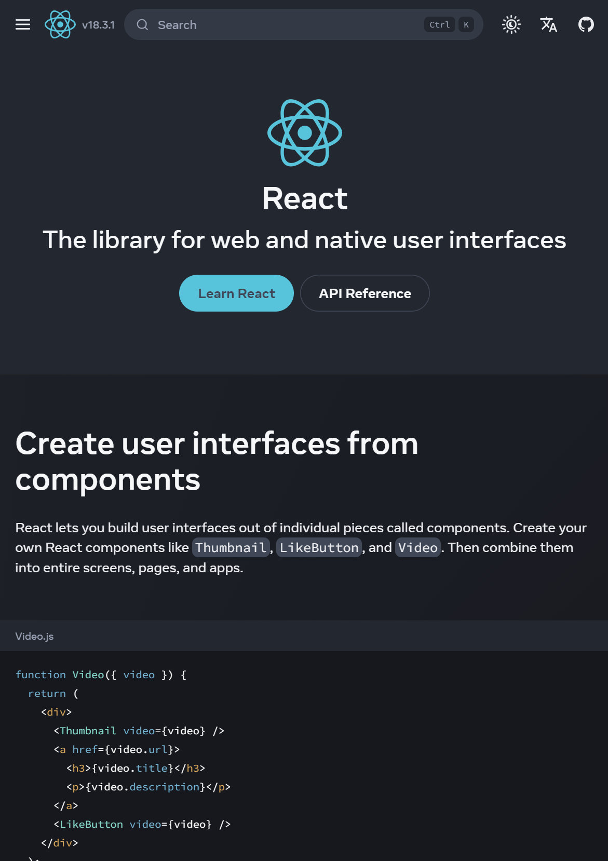
React 19 – Upgrade Guide
Upgrading to React 19
npm install --save-exact react@rc react-dom@rc
https://react.dev/blog/2024/04/25/react-19-upgrade-guide
77
Notes:
There’s also codemods that will automatically update your code to many of the new APIs and patterns in React 19

Slide 78

React 19
react.dev/blog/2024/04/25/react-19
78
Notes:
For more details on React 19 visit the official React dev site

Slide 79

React 19
Questions?
79

Slide 80

React 19
THANK YOU
Enjoy the rest of your day.
80

Slide 81








